Slide 1

Social And Information Networks Review – 3
Movie Recommendation and Rating Website
Project by:
K.G.Nithesh Gurudaas, 18BCE1101
Sruti Verma, 18BCE1005

Slide 2
AIM
The aim of MOVIE RECOMMENEDATION AND RATING WEBSITE is to RECOMMEND THE USER MOVIES BASED UPON HIS INTEREST using HTML,CSS,JS,PHP,PYTHON,JUPYTER,NOTEBOOK,NOTEPAD.

Slide 3
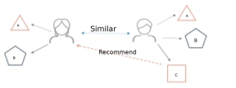
A recommender system is a simple algorithm whose aim is to provide the most relevant information to a user by discovering patterns in a dataset.
The algorithm rates the items and shows the user the items that they would rate highly.
An example of recommendation in action is when you visit Amazon and you notice that some items are being recommended to you or when Netflix recommends certain movies to you.
They are also used by Music streaming applications such as Spotify and Deezer to recommend music that you might like.

Slide 4
HOW IT IS RELATED TO SOCIAL NETWORKING?
This project is extrapolated to social networking
because several websites use similar recommendation algorithms
such as YouTube and Facebook and Instagram
as they suggest friends based on your circle, videos based on what you have watched.

Slide 5
Parts completed till Review-2
Idea for the project was developed
Outlook of the website and HTML codes were written
Tables for storing data were created, and database connection with website was done
Successfully created a program for recommending movies similar to the movie entered

Slide 6
Objectives Reached
Created a chat application that allows two users to chat with each other
Created the outlook for the python/ Jupyter notebook app, that makes it user friendly
Aesthetic improvements were made to the entire website and project

Slide 7
METHODOLOGY
Cosine similarity is a similarity function that is often used in information retrieval, and it is also one of the most popular similarity calculations applied to text documents, for numerous information retrieval applications , as well as clustering . When documents are represented as vectors, the similarity in two documents corresponds to the correlation between the vectors. This is quantified as the cosine of the angle between vectors. Given two documents ta→ta→ and tb→tb→, their cosine similarity can be represented as SIMC(ta→,tb→)=ta→.tb→∣∣∣ta→∣∣∣×∣∣∣tb→∣∣∣SIMC(ta→,tb→)=ta→.tb→|ta→|×|tb→| (1) where ta→ta→ and tb→tb→ are m-dimensional vectors over the term set T = {t1,…, tm}.

Slide 8
Each dimension represents a weight in the document, which is non-negative and bounded between [0, 1]. For example, when combining two identical copies of document d to get a new pseudo document d’, the cosine similarity between d and d’ is 1, which means that these two documents are regarded to be identical. At the same time, given another document l, d and d’ will have the same similarity value as that of l, that is SIM(td→,tl→)=SIM(td′−→,tl→)SIM(td→,tl→)=SIM(td′→,tl→). Otherwise, documents with the same composition but different totals will be treated identically. When the term vectors are normalized to a unit length such as 1, the representation of d and d’ will be the same. Movies with high cosine similarity is very similar to the one entered by user Then, we sort the movies based on this value and, the movies with the top ten values are displayed on screen from a dataset of almost 5000 movies .

Slide 9
OVERVIEW OF LANGUAGES USED
Hypertext Markup Language (HTML) is the standard markup language for documents designed to be displayed in a web browser. It can be assisted by technologies such as Cascading Style Sheets and scripting languages such as JavaScript.
Cascading Style Sheets (CSS) is a style sheet language used for describing the presentation of a document written in a markup language like HTML. CSS is a cornerstone technology of the World Wide Web, alongside HTML and JavaScript.
JavaScript, often abbreviated as JS, is a programming language that conforms to the ECMAScript specification. JavaScript is high-level, often just-in-time compiled, and multi-paradigm. It has curly-bracket syntax, dynamic typing, prototype-based object-orientation, and first-class functions.

Slide 10
jQuery is a JavaScript library designed to simplify HTML DOM tree traversal and manipulation, as well as event handling, CSS animation, and Ajax. It is free, open-source software using the permissive MIT License.
PHP is a popular general-purpose scripting language that is especially suited to web development for back end. It was originally created by Rasmus Lerdorf in 1994; the PHP reference implementation is now produced by The PHP Group.
Python is an interpreted, high-level, general-purpose programming language. Created by Guido van Rossum and first released in 1991, Python's design philosophy emphasizes code readability with its notable use of significant whitespace.

Slide 11
OVERVIEW OF SOFTWARE USED
XAMPP – for running localhost is a free and open-source cross-platform web server solution stack package developed by Apache Friends, consisting mainly of the Apache HTTP Server, MariaDB database, and interpreters for scripts written in the PHP and Perl programming languages. WE HAVE USED XAMPP FOR RUNNING OUR WEBSITE.
Notepad is a simple text editor for Microsoft Windows and a basic text-editing program which enables computer users to create documents. It was first released as a mouse-based MS-DOS program in 1983, and has been included in all versions of Microsoft Windows since Windows 1.0 in 1985.

Slide 12
WE HAVE USED NOTEPAD FOR WRITING HTML, CSS, JS, AND SUBLIME TEXT EDITOR FOR PHP CODE. PyCharm-Python web server is an integrated development environment used in computer programming, specifically for the Python language. It is developed by the Czech company JetBrains.
Project Jupyter is a nonprofit organization created to "develop open-source software, open-standards, and services for interactive computing across dozens of programming languages". Spun-off from IPython in 2014 by Fernando Pérez, Project Jupyter supports execution environments in several dozen languages.

Slide 13
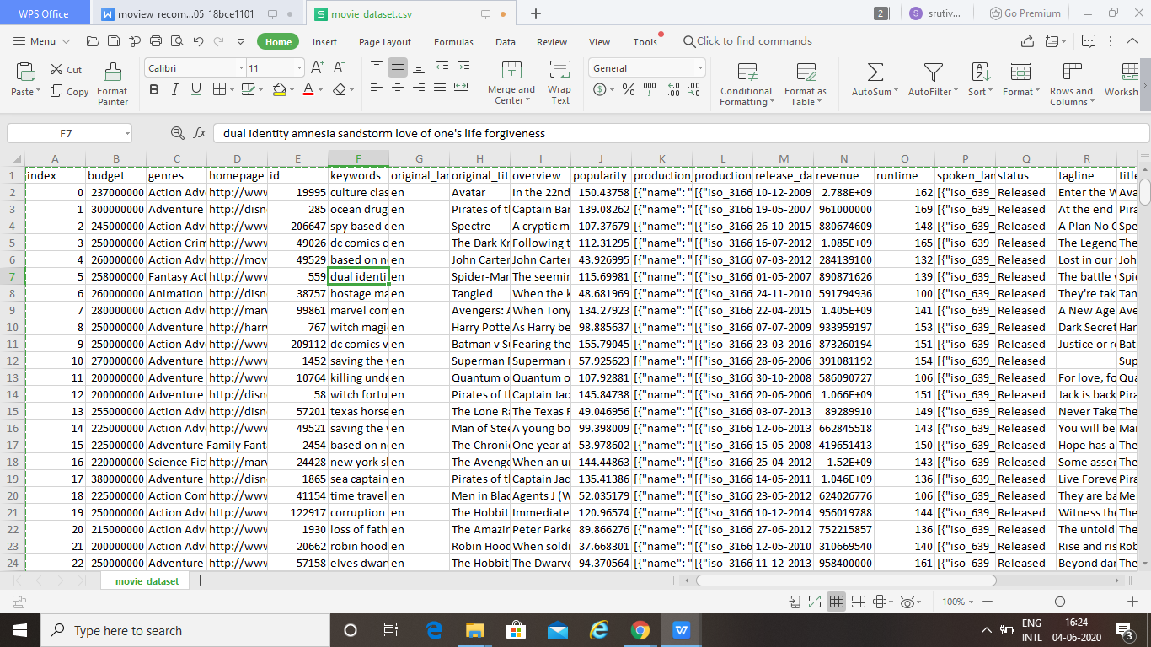
DATASETS

Slide 14
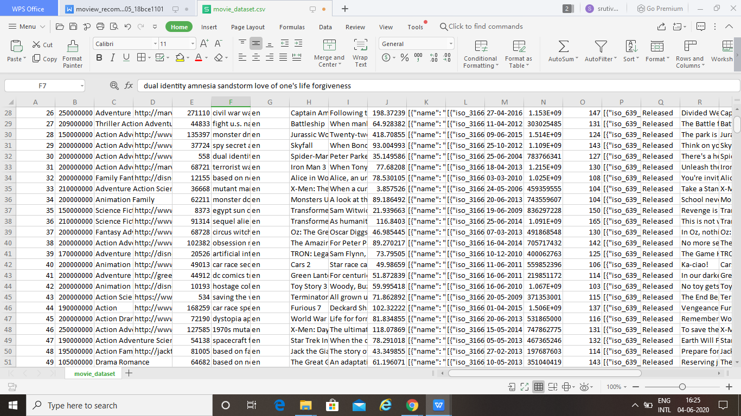
DATASETS

Slide 15
1.HOME PAGE It consists of various categories of movies for the user like ADVENTURE,ACTION,ANIMATION,COMEDY,DRAMA,THRILLER,CRIME,MUSIC,ROMANCE,SCI-FI. After clicking ACTION,the user can get movies related to ACTION. The HOME PAGE also consists of pictures of many movies moving through a slide show.
Module description

Slide 16
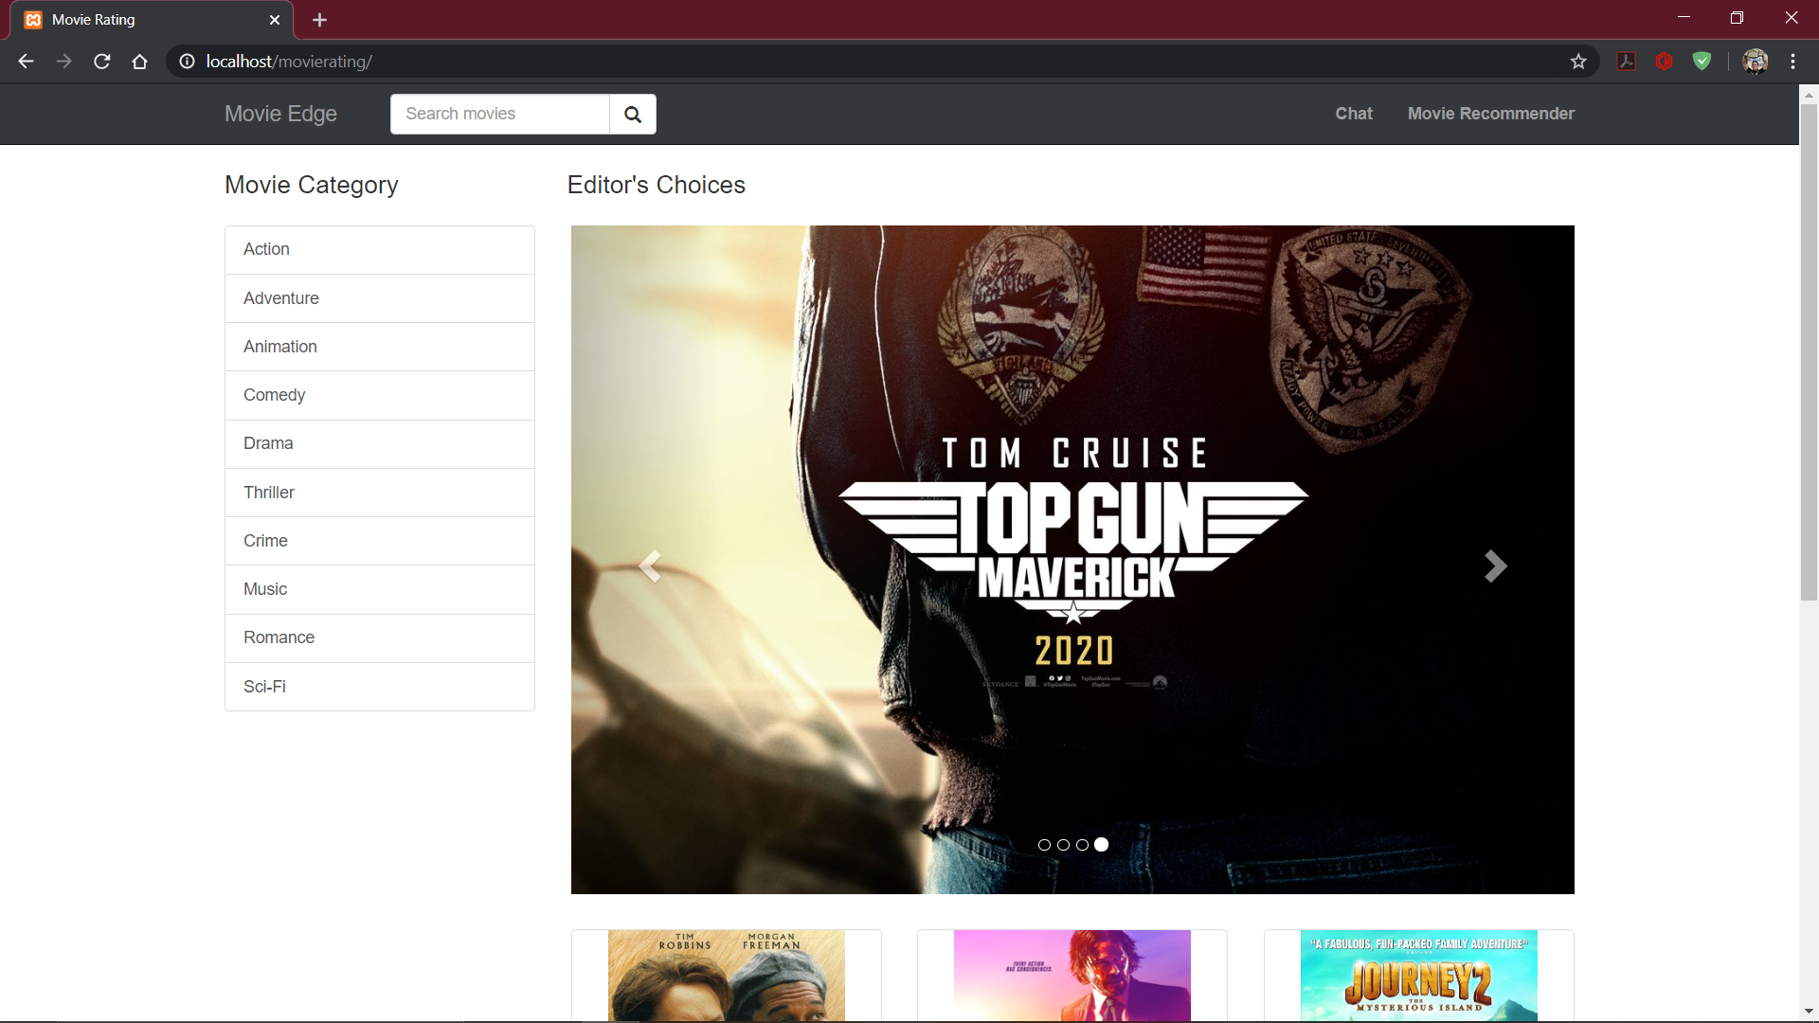
Movie Rating homepage

Slide 17
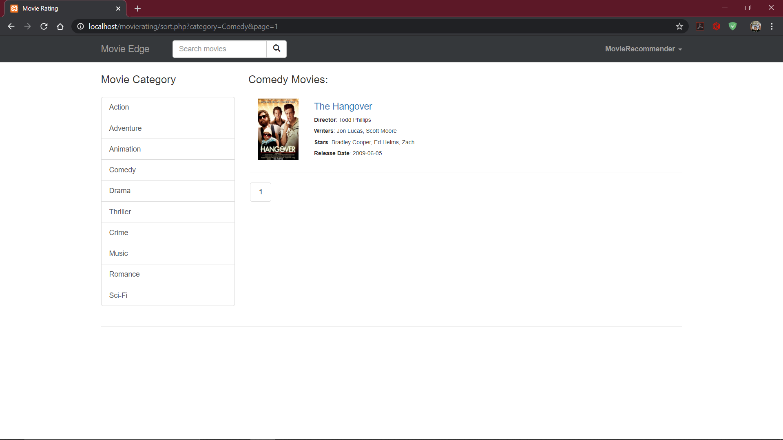
Movies sorted according to filter

Slide 18
2. Movie Recommendation website front end
You have to enter a movie name and after clicking search button you will be given movies list which are similar to the movie entered.

Slide 19
3.Explanation of execution(Movie Recommendation only)
First, the title of the movie is entered, exactly as it is stored in the database. This input is passed as an argument to the python program.
Each movie has a set of keywords, cast, genre and director, and some more attributes. These attributes of the given movie, are taken as a reference point.

Slide 20
The attributes of other movies are compared to the reference attributes via a similarity cosine function to find out a value that can be used for finding out how interrelated the movies are to the movie provided in the argument.
Then, we sort the movies based on this value and, the movies with the top ten values are displayed on screen from a dataset of almost 5000 movies.
This is all done by the backend python server and output is sent to the html page which will interpret the output and display it.

Slide 21
4.Explanation of backend
We have created a table that contains all the information about the movies, such as title, release date, actors, director, rating, etc
PHP code extracts all the movies and displays it in the homepage.
PHP code also has a sort function to filter movies based on criteria

Slide 22
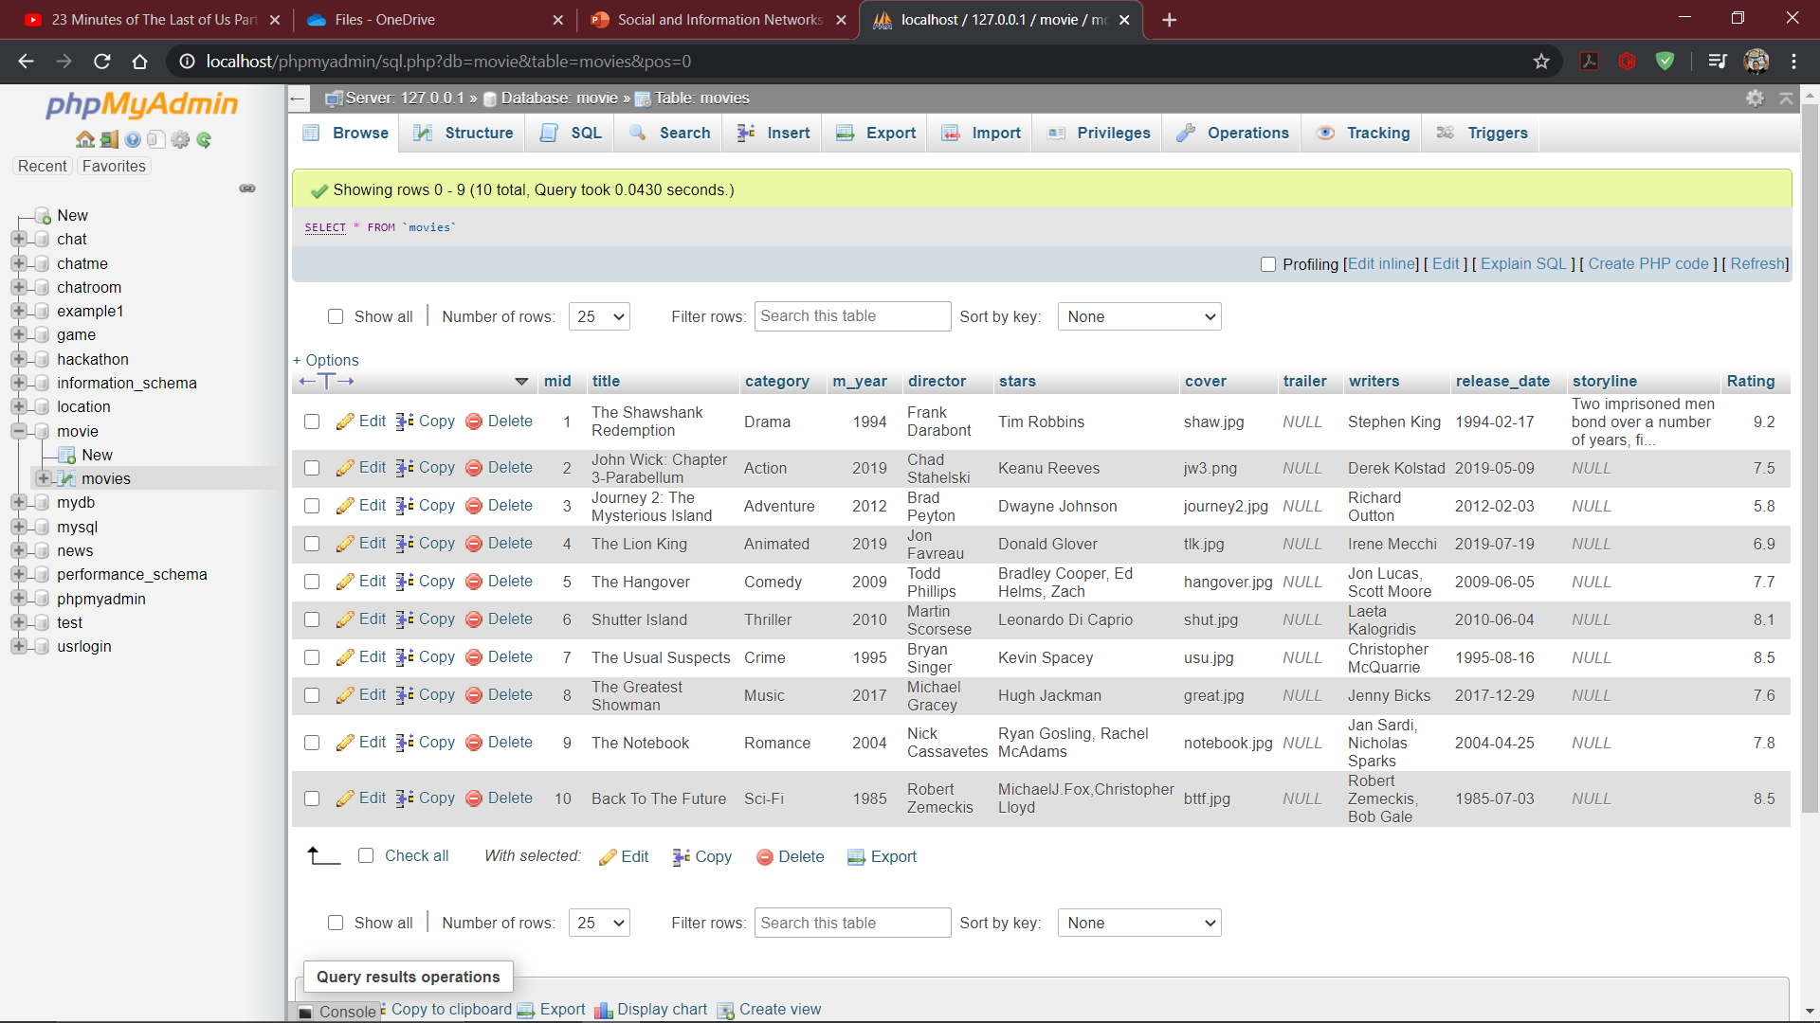
Movies database

Slide 23
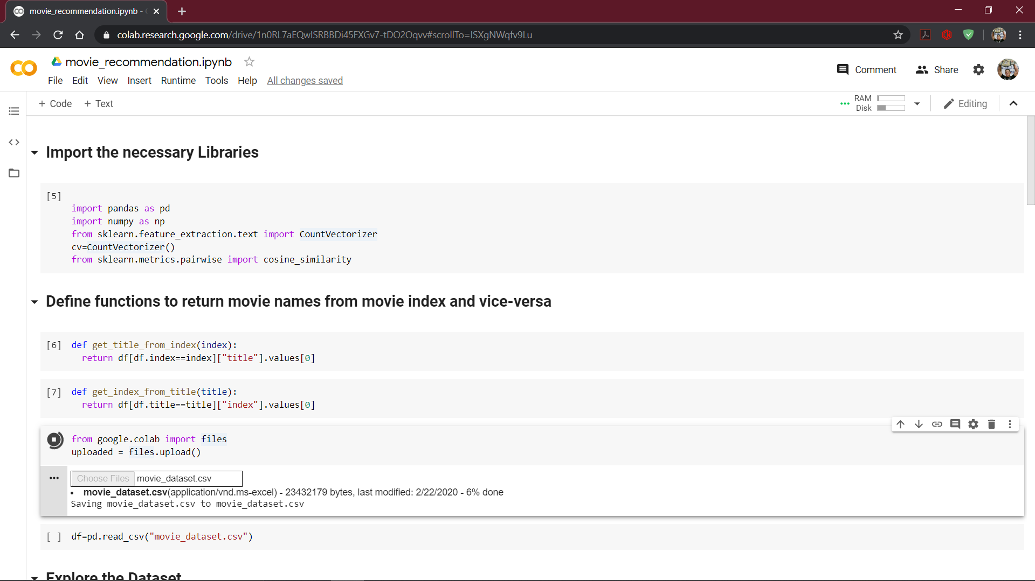
Jupyter notebook for Movie Recommendation

Slide 24
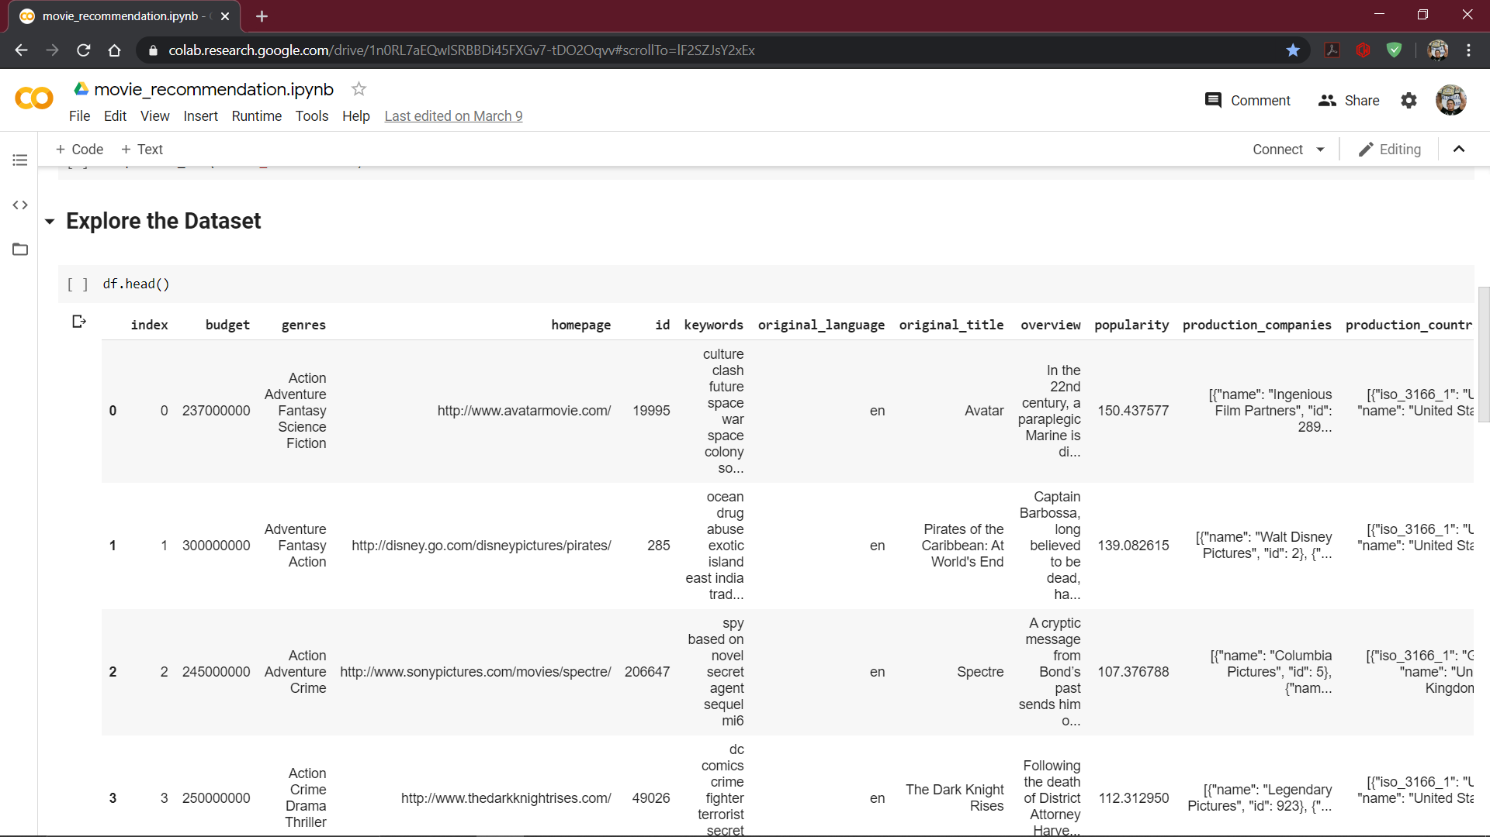
Dataset attributes

Slide 25
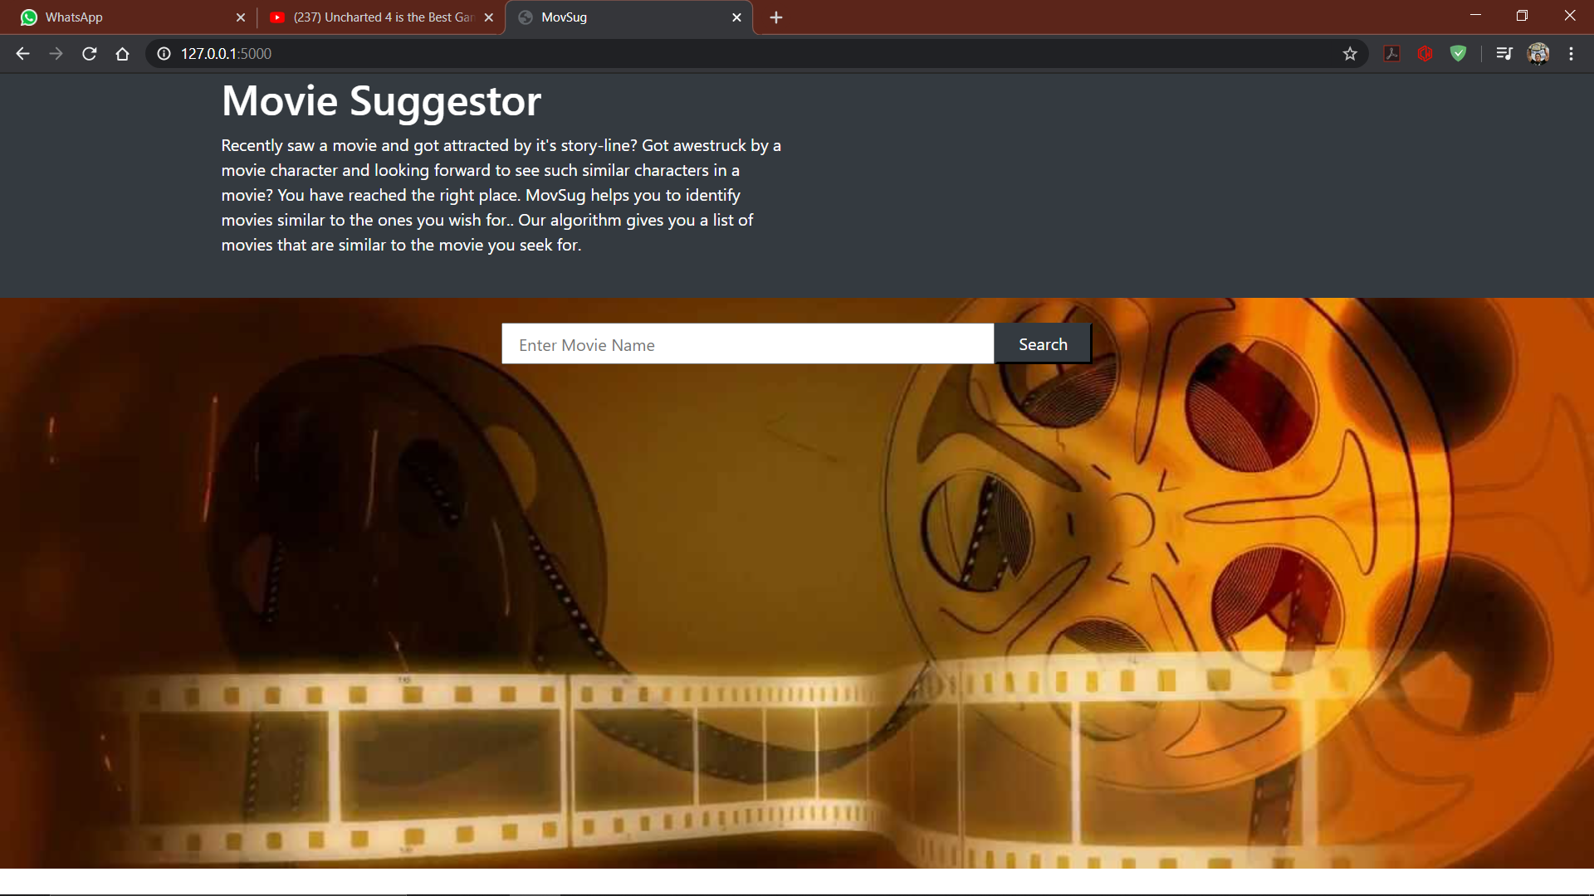
Movie Recommendation webpage

Slide 26

Input and results(THE AVENGERS MOVIE IS TYPED IN SEARCH BAR AND SIMILAR MOVIES TO IT ARE DISPLAYED)

Slide 27
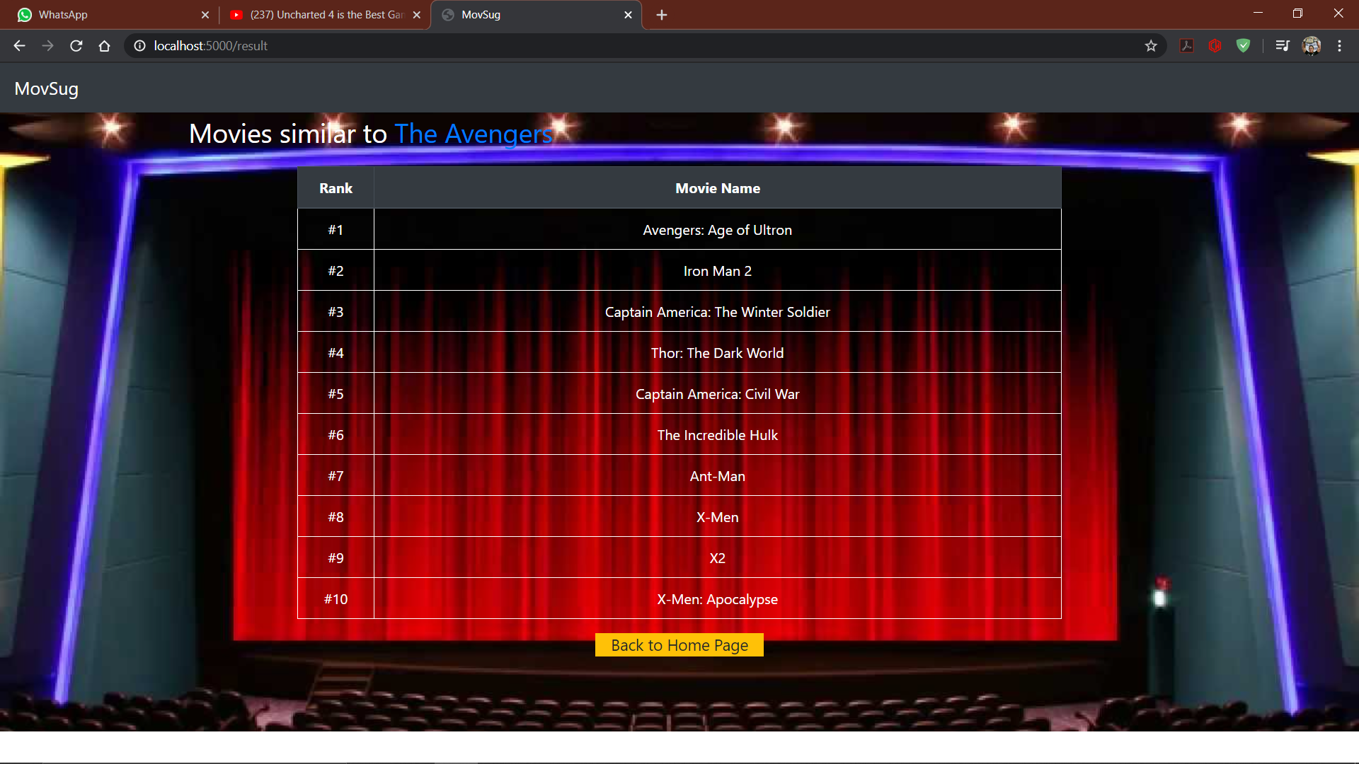

Slide 28

5.Explanation of Chat app
First, users will have to register in the Chat app
Next, they can log in and start chatting with other users
They have an option next to the username of each user, to start a chat with them. They can text and send images and can also delete messages or images they no longer need.
There is also a group chat option to converse with everyone present in the chat application
Users can then log out after conversing with the desired person

Slide 29
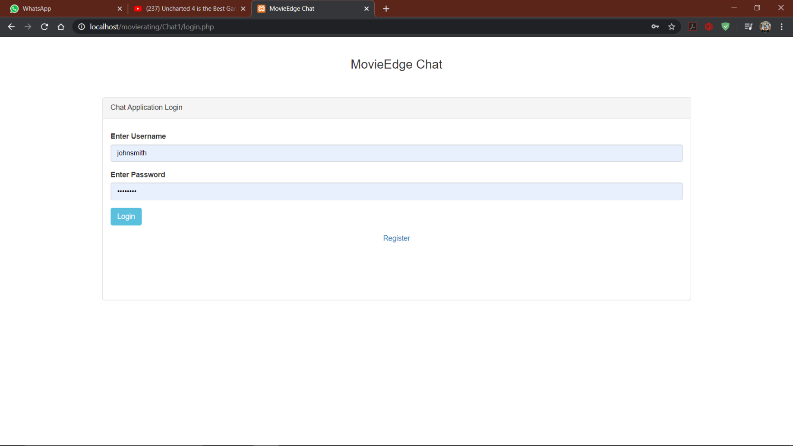
Chat Login Page

Slide 30
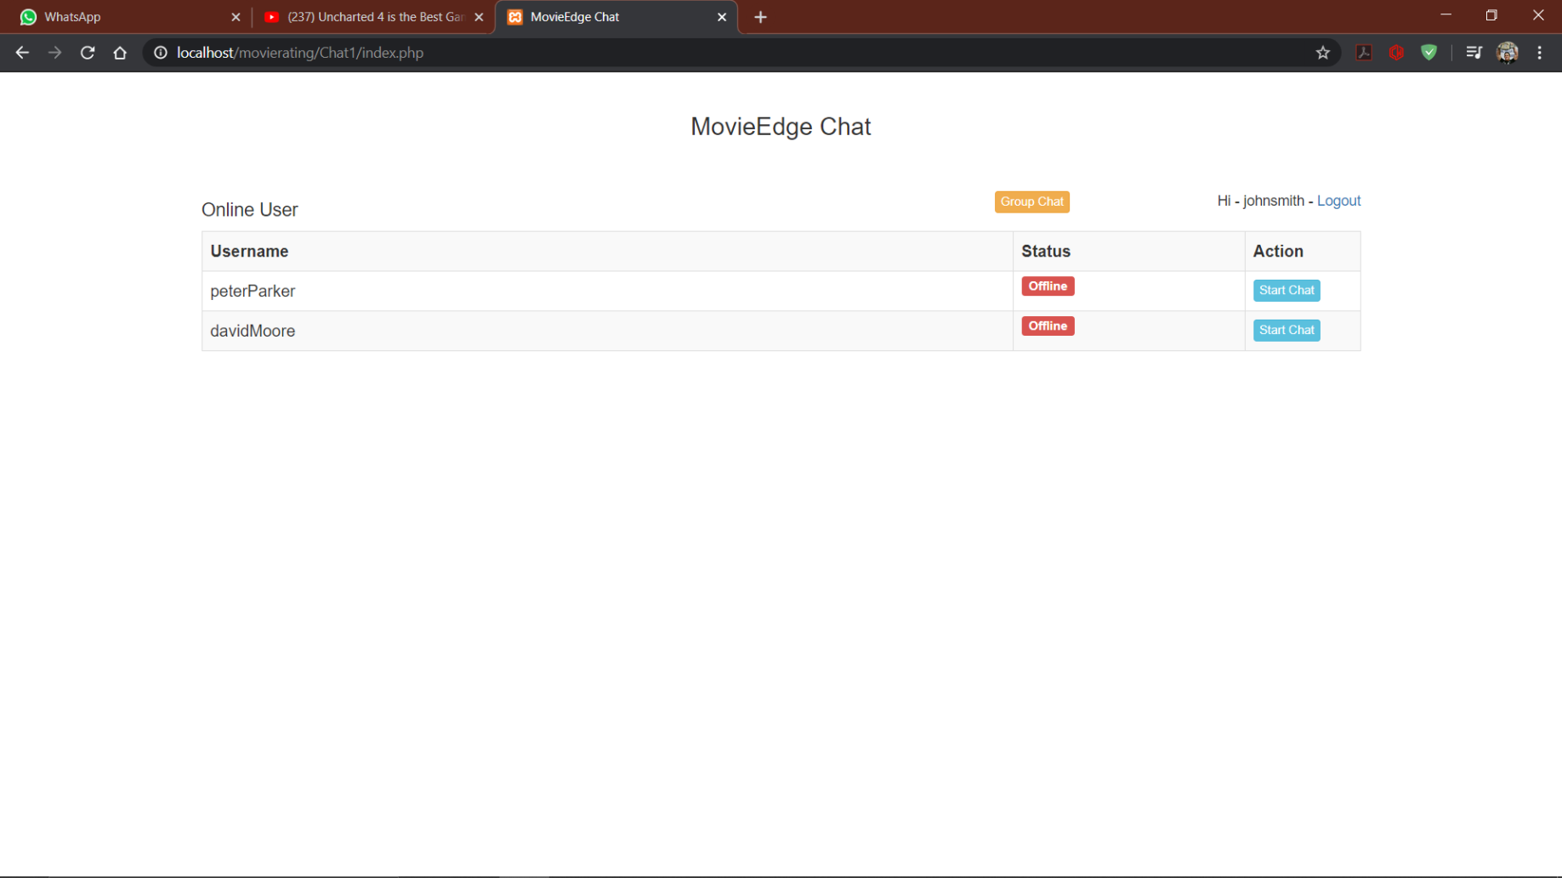
Chatroom homepage

Slide 31
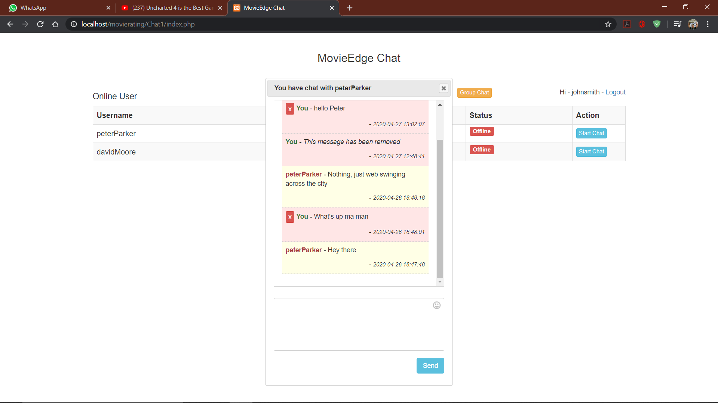
Chatting window
Chat window with deleted texts and random text messages

Slide 32
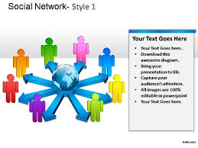

6.Explanation of backend of chat forum
A table is present for the users, and it collects data about username and password. A separate table is used for storing messages, and it contains data such as the message, sender username, receiver username, timestamp.

Slide 33
Upon registration, a form is called to insert the values into the users table.
When a user sends a message to receiver, another form is called that inserts all the values, such as sender username, receiver username, message, etc into the messages table.
Login verification is done by JavaScript and PHP combined.

Slide 34
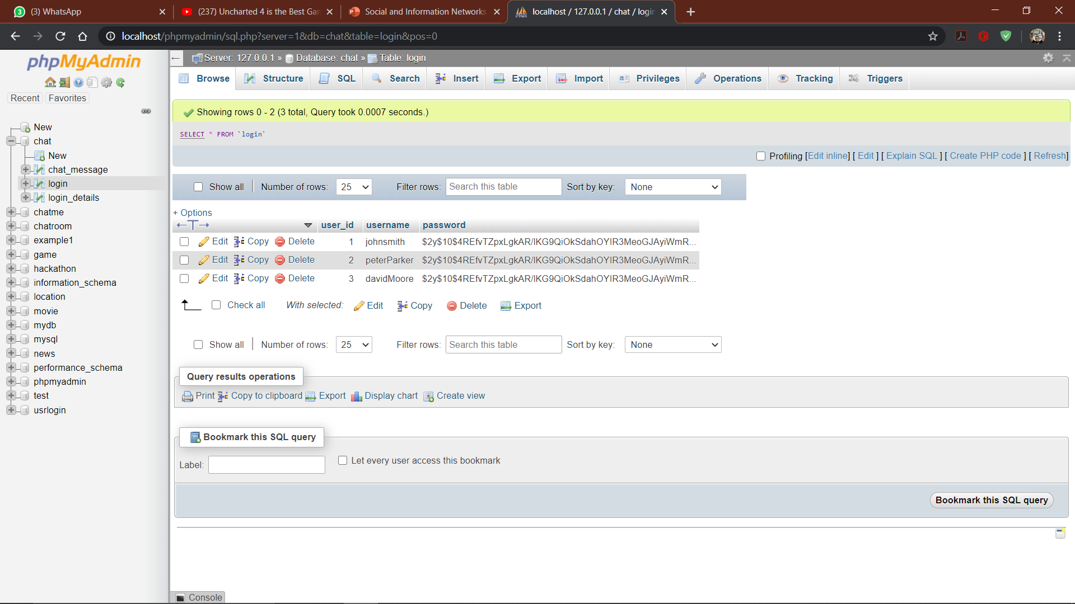
Table of Users, along with encrypted password

Slide 35
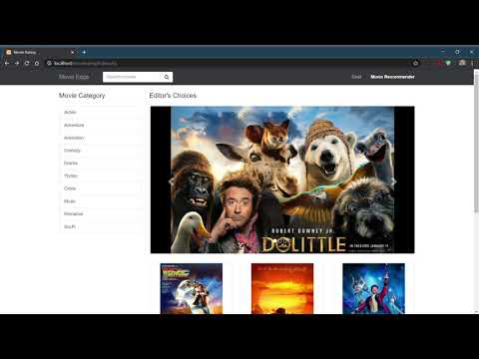
Short video of execution
Kindly watch this video on the execution of our project
FOLLOW THIS LINK IF VIDEO IS NOT WORKING: https://youtu.be/fYQL5APQcf8

Slide 36
CONCLUSION
We have used our knowledge of SOCIAL NETWORK AND INFORMATION AND INTERNET AND WEB DEVELOPMENT courses and have successfully made a MOVIE RECOMMENDATION AND RATING WEBSITE which gives lists of similar movies associated with the movie entered in search bar which works with the methodology Cosine similarity measure. We have also developed a CHATTING FORUM for our users to chat and discuss about any movies.Our website UI is highly interactive and well decorated through features of CSS AND JQUERY.The DATABASE works very well and is developed by PHP.

Slide 37
Contribution of Each member
Nithesh: Database handling and connection with front end, Movie Recommendation webpage, Movie Recommendation program
Sruti: Front end (Web page development of movie ratings website), Movie Recommendation Program, Chat application

Slide 38

Thank You

